Slide 1
China Travel
A06：Sam, Stefan, Leo
2018-12-07

Slide 2
Contents
1. Culture
2. Sceneries
3. Development
4. Conclusion

Slide 3
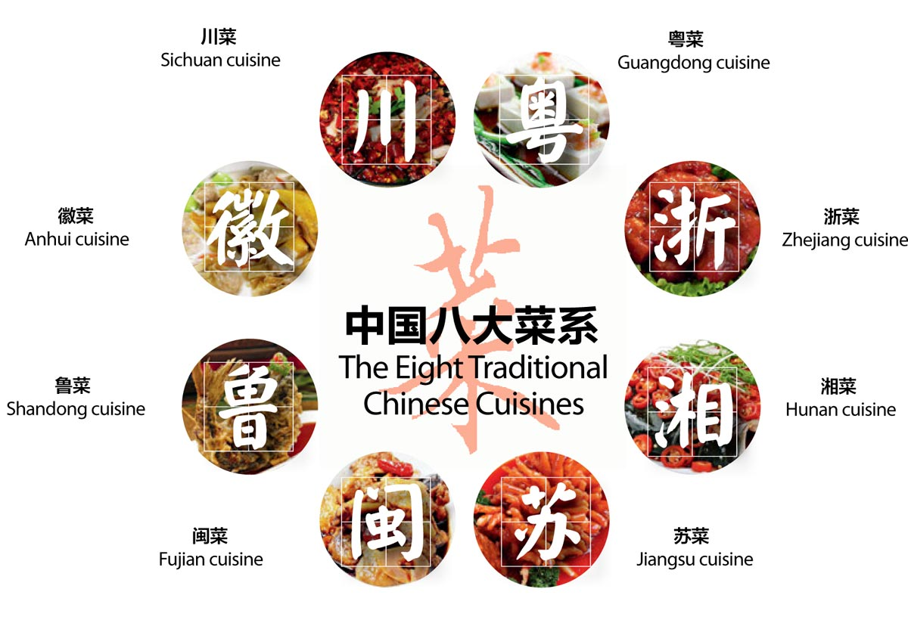
Culture - Food

Slide 4
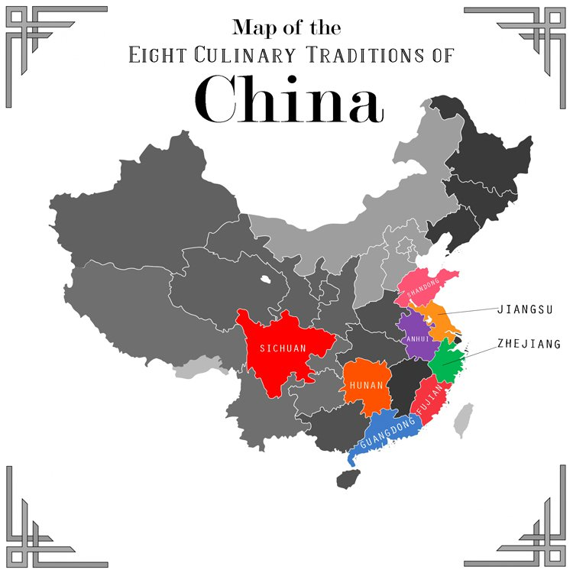
Culture - Food
Northern — salty, simple, less vegetables with wheat as the staple food
Western — hearty halal food with lamb the main meat
Central — spicy with a lot of seasonings
Eastern — sweet and light
Southern minorit — sour
Notes:
https://hakkasan.com/blog/eight-culinary-traditions-china/ http://blog.tutorming.com/expats/types-of-chinese-food
Chinese cuisine is very elaborate and sophisticated. The diversity of geographical locations, climatic and customary variations, as well as special produces, has led to the evolution of various regional cuisines with their own characteristics and cooking styles.
China's regional cuisines (very) generally taste as follows:
Northern China food — salty, simple, less vegetables with wheat as the staple food
Western China food — hearty halal food with lamb the main meat
Central China food — spicy with a lot of seasonings
Eastern China food — sweet and light
Southern minority food — sour

Slide 5
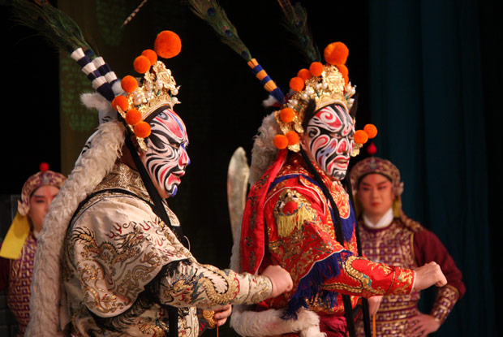
Culture - Opera
Chinese musical drama
Notes:
http://chungantiques.com/chinese-antiques-reference-research/2016/6/22/history-of-chinese-opera https://www.wikiwand.com/en/Theatre_of_China

Slide 6


Culture - Opera
Chinese Opera evolved from folk songs, dances, talking, antimasque, and especially distinctive dialectical music. Gradually it combined music, art and literature into one performance on the stage.
Notes:
https://www.travelchinaguide.com/intro/arts/chinese-opera.htm

Slide 7
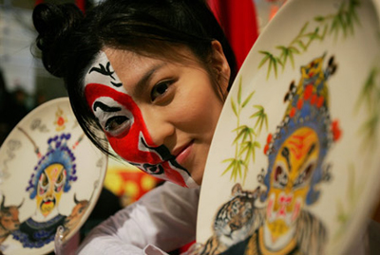
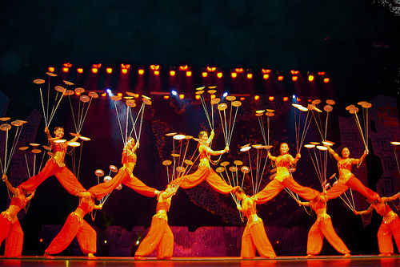
Culture - Opera
Facial make-up
Acrobatics
Symbolling a character's personality, role, and fate.
One minute's performance on the stage takes ten years'practice behind the scenes.
Notes:
https://www.travelchinaguide.com/intro/arts/chinese-opera.htm facial make-up: symbolize a character's personality, role, and fate. Generally, a red face represents loyalty and bravery; a black face, valor; yellow and white faces, duplicity; and golden and silver faces, mystery.
Acrobatics: Players can make fire spray out of their mouths when they act as spirits. This reflects a saying among actors: 'One minute's performance on the stage takes ten years'practice behind the scenes.'

Slide 8
Sceneries in China

Slide 9
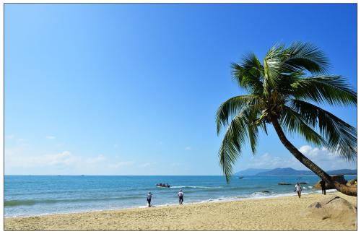
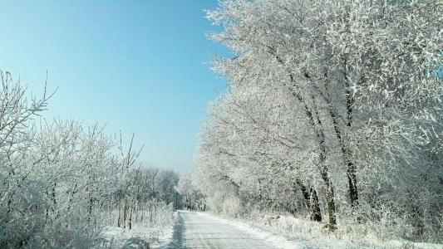
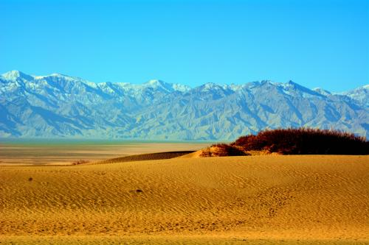
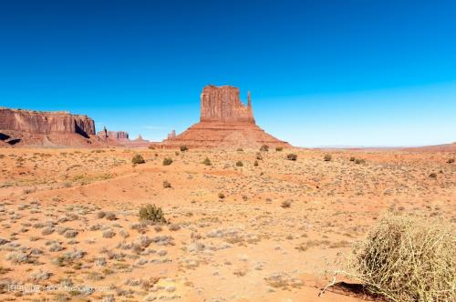
Different climates

Slide 10
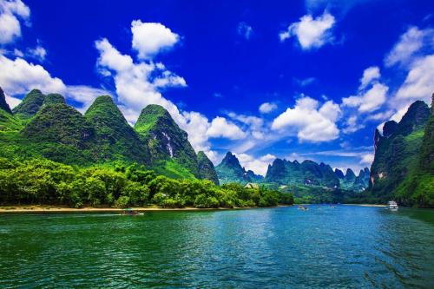
Different natural sceneries
Guilin has a typical karst landform, which is famous worldwide.
Guilin, Guangxi

Slide 11
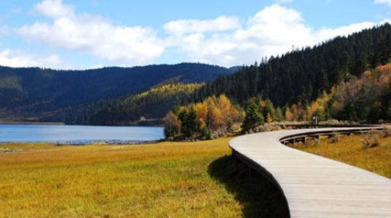
Different natural sceneries
Typical tundra climate in plateau nourish many Chinese precious plant and animal species.
Pudazo national forest park, Shangri- La, Yunnan

Slide 12
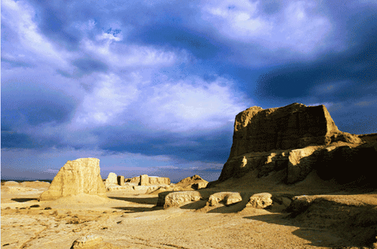
Different natural sceneries
Desert always means wild. We regard Karamay desert as a must-go site to feel different China.
Karamay desert, Xinjiang

Slide 13
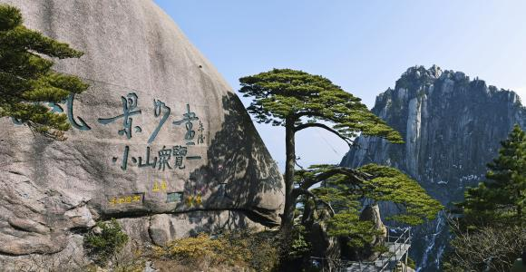
Different natural sceneries
Huang mountain, Anhui
It is one of the most famous mountains in China not only natural bust also cultural.

Slide 14
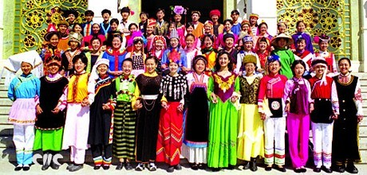
Nature and culture
Different natural environment
Different diet and life habit
Multi-ethnic country
56 nations

Slide 15
Development of China

Slide 16
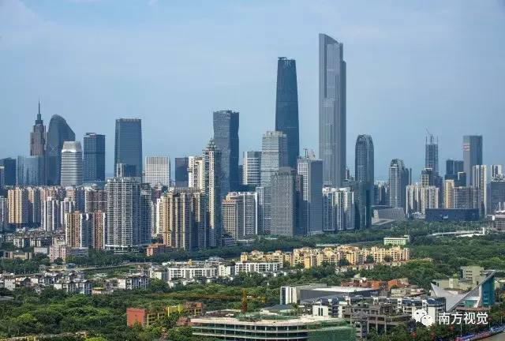
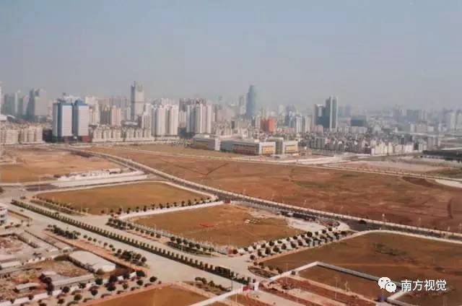
Where’s this?
1986’s Zhujiang New town

Slide 17
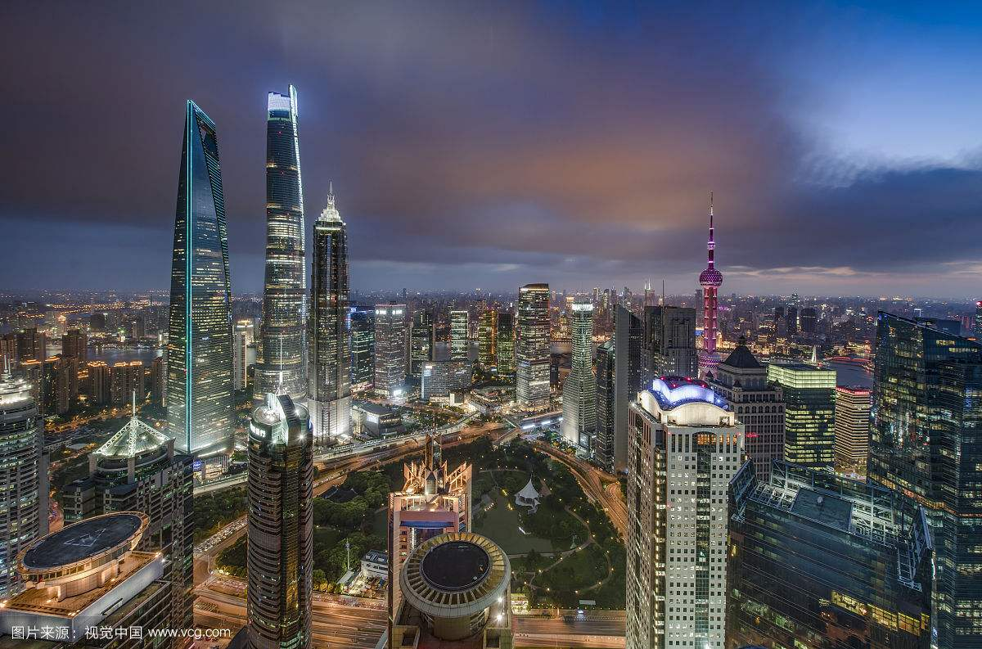
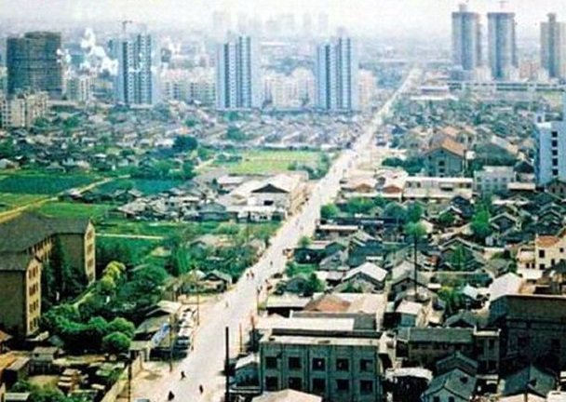
Where’s this?
1990’s Pudong Shanghai

Slide 18
Development
It never occurred to people that in just 40 years, such a huge change could take place in China's big cities. Of course, the change is not only the appearance of the city, but also people's way of life.

Slide 19
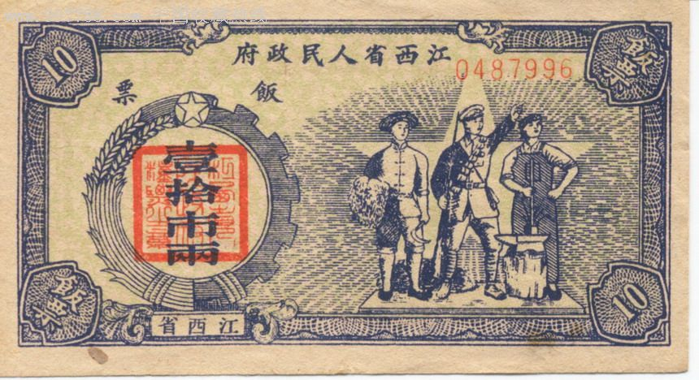
Development
Meal ticket

Slide 20

Development
But today, you can buy everything in every supermarket in China. You even stroll on the street for whole day without cash but a mobile phone.

Slide 21
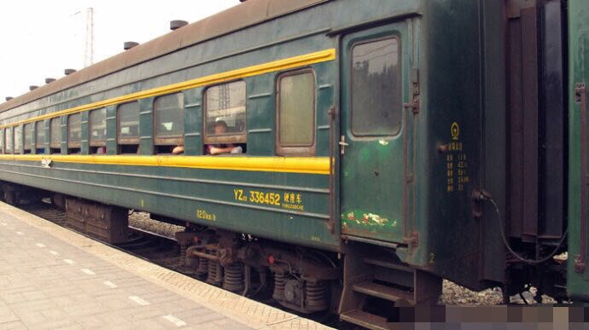
Development
In 1974, if you took a train from Guangzhou to Shaoguan, it would take you seven hours on the way

Slide 22
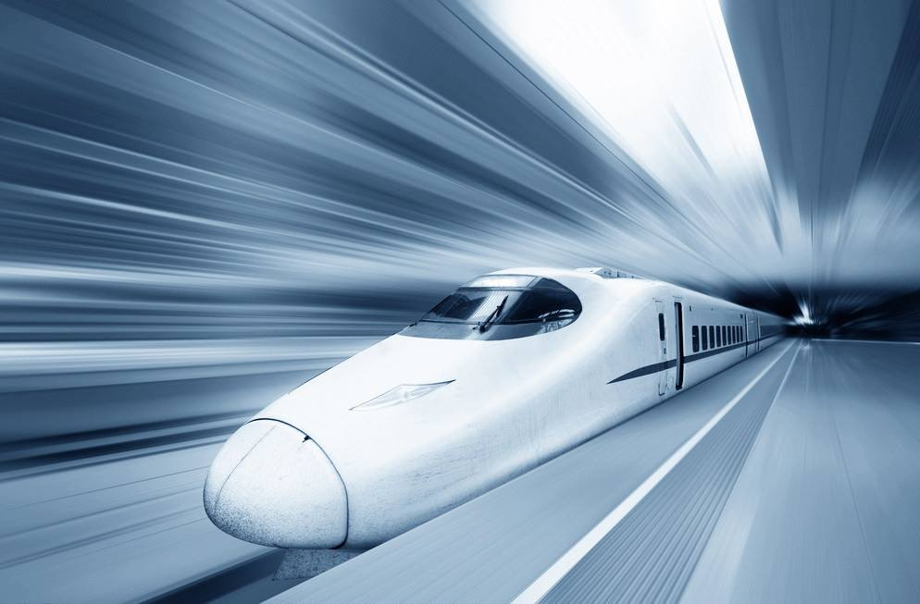

Development
But now, if you take the high-speed rail

Slide 23
Summary
After 40 years of reform and opening up, China has gradually caught up with developed countries and made innovative progress in some areas. And she is a new and vibrant country, she will not stop the pace of development. That's why I recommend coming to China.

